Slide 1
SmartEye
Muhammad Anas Khan
Syed Saad Ahmed
Abbas Ahmed Tatari

Slide 2
Introduction
Problem Statement:
  Given a set of stereo images, predict what the object is
Example:
  The object is a chair – Truth value 75%

Slide 3
Limitations & Constraints
The image should have a single object
The object should be some geometric figure other than spheres/circles
Foreground Color : Black
Background Color: Any Color
Single Pixel Image
Image Size: 400 X 300
Format: Preferably Bitmap
The object should form a connected graph

Slide 4
Important Definitions
Stereo Images:
  Two images of the same object from slightly different angles helping to perceive depth
Stereo Distance:
  Distance between two devices capturing the image of the same object e.g. human eyes
Depth Perception:
  It is the visual ability to perceive the world in three dimensions

Slide 5
Important Definitions
Camera Distance:
  Distance of the camera from the image
Triangulation Principle:
  Determining the location of a point by measuring angles to it from known points of a fixed based line

Slide 6
History of Triangulation
The use of triangles to estimate distances goes back to ancient times
Used to estimate the height of the pyramids by measuring the length of their shadows
Used to estimate the distances to ships at sea as seen from a cliff top

Slide 7
Project Evolution
Canny Edge Detection:
  No mathematical representation of edges
Harris Corner Detection:
  Poor results
Devised our own edge detection algorithm
No use of library

Slide 8
Phases in Brief
Edge Detection
Depth Perception
Object Identification

Slide 9
Edge Detection
Input: Stereo images of object
Output: List of edges of object

Slide 10
Detecting Segments
Mask size: 3 x 3
Recursive call fashion: top left to bottom right
While traversing, mark pixels as visited
Add visited pixels to the list EdgePixels of size edgePixelCount
When the list is full check for the segment

Slide 11
Detecting Segments
Equation of a line between two points: EdgePixels.First and EdgePixels.Last
y = mx + b
=> mx – y + b = 0
=> Ax + By + C = 0
Perpendicular distance between the line Ax + By + C = 0 and pixel (m,n)
Distance = | Am + Bn + C | / Sqrt( A² + B² )

Slide 12
Detecting Segments
If Distance <= pointLineDistance then onlinePixels++
Percentage of onlinePixels
If Percentage >= edgePercentage then create an edge(EdgePixels.First, EdgePixel.Last)
Otherwise there is CornerPixel in list

Slide 13
Detecting Segments
CornerPixel: maximum no. of neighboring pixels
Edge(EdgePixels.First, CornerPixel)
Edge(CornerPixel, EdgePixels.Last)
Finally clear EdgePixels list

Slide 14
Merging Segments
If two segments S1 and S2 are collinear then merge them into single edge E such that: E(S1.Point1, S2.Point2)
S1 and S2 are collinear if distance between them <= edgeEdgeDistance and angle >= segmentCollinearityAngle

Slide 15
Merging Segments
For angle, we use
Theta = Cos⁻¹(AB.CD / |AB||CD|)
Theta = 180 - Theta

Slide 16
Connecting Edges
Some edges get disconnected
If distance between two edges <= edgeConnectDistance then connect them otherwise not

Slide 17
Merging Edges
Resolves the visual intersection problem
If two edges are collinear then merge them into single edge

Slide 18
Depth Perception
Input: List of edges of object
Output: List of 3D edges of object

Slide 19
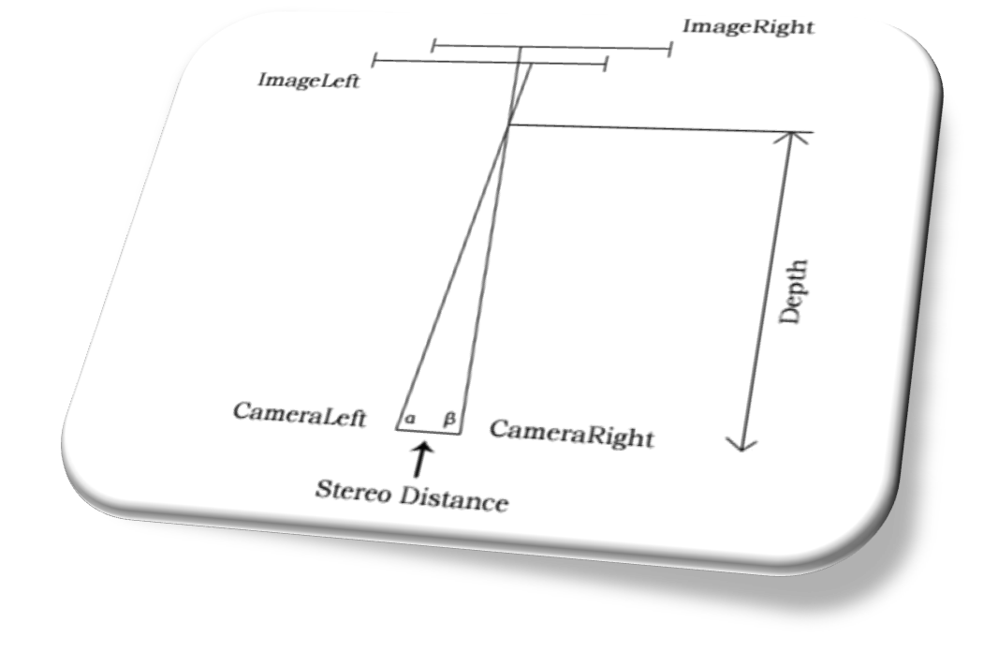
Triangulation Model

Slide 20
Depth Perception
Stereo Correspondence
  Edge Correspondence
  Point Correspondence

Slide 21
Depth Perception
Edge Correspondence
Two edges are in correspondence if they are parallel and the perpendicular distance between them is minimum
For parallelism, we compare slopes of two edges m = Y₂ – Y₁ / X₂ – X₁

Slide 22
Depth Perception
Edge Correspondence
For perpendicular distance, we find distance between a point of edgeLeft and the edgeRight itself using point line distance formula:
Distance = | Am + Bn + C | / Sqrt( A² + B² )

Slide 23
Depth Perception
Point Correspondence
For two corresponding edges, we need corresponding points
Two points are in correspondence, if they are closest to each other among others

Slide 24
Depth Perception
Image Angle Calculation
We need to find angles over the width of the image
For left image, anti-clockwise angle calculation as it corresponds to left camera
For right image, clockwise angle calculation as it corresponds to right camera

Slide 25
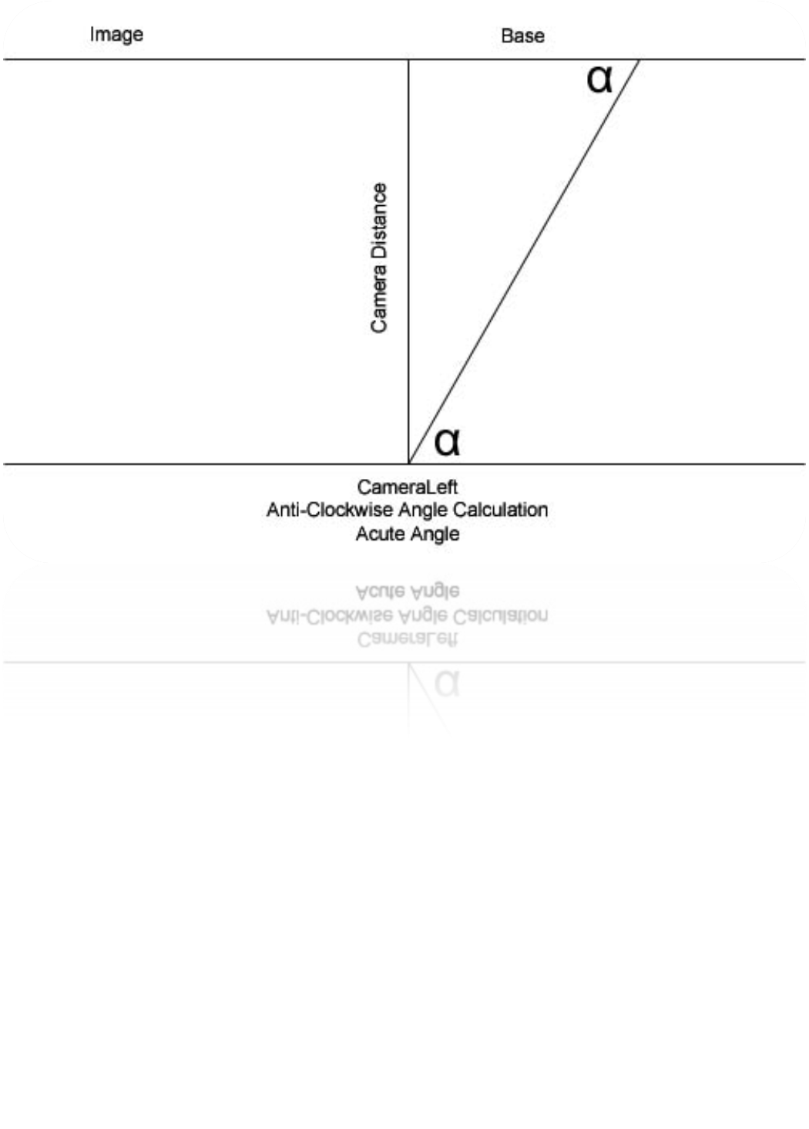

Slide 26
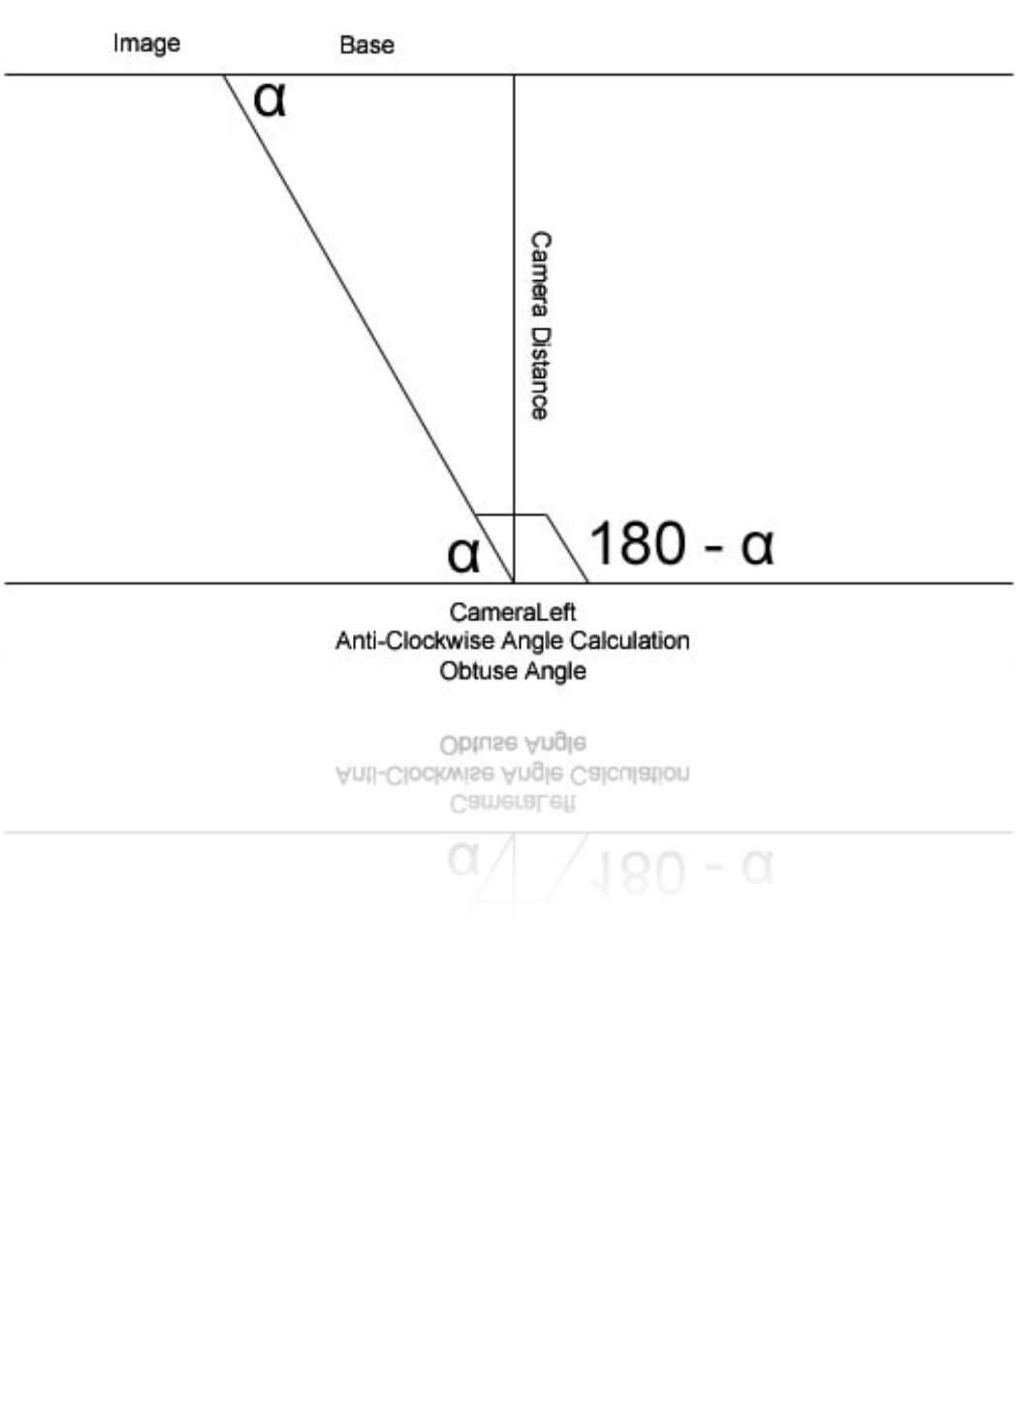

Slide 27
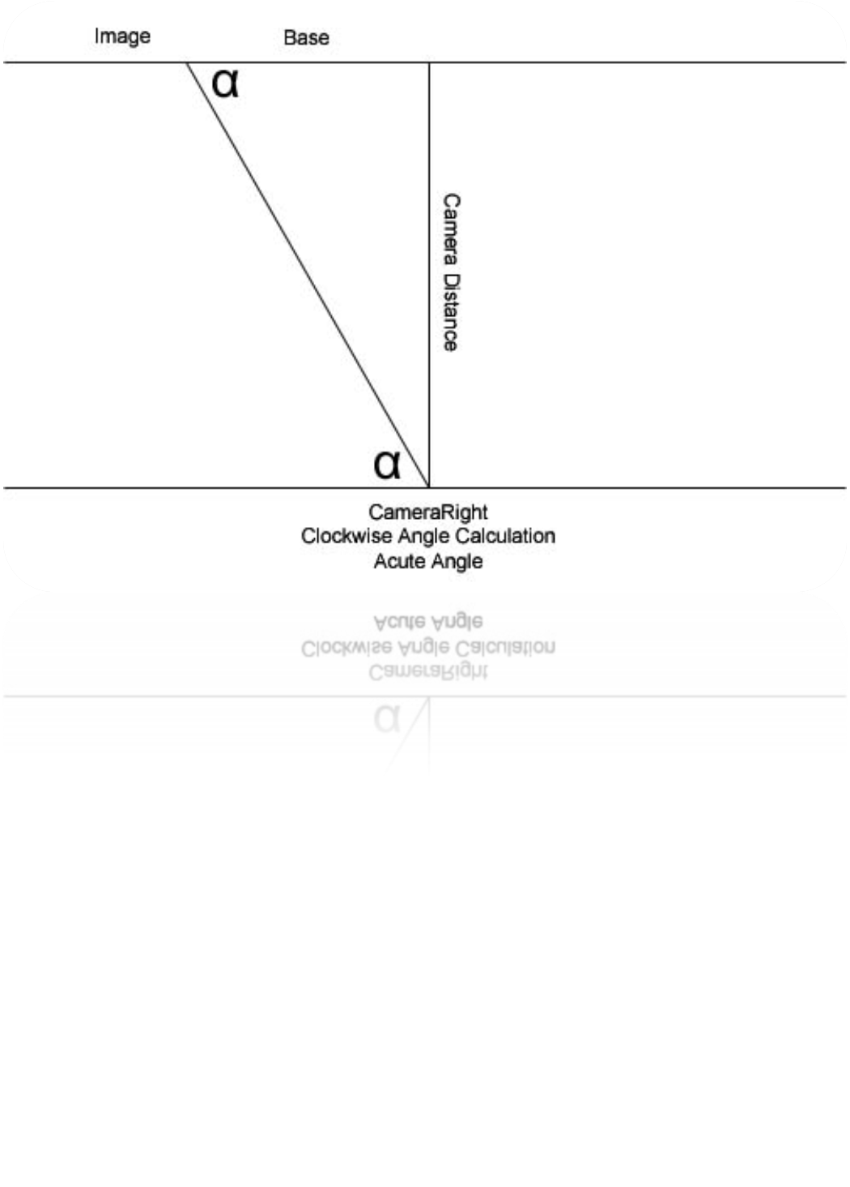

Slide 28
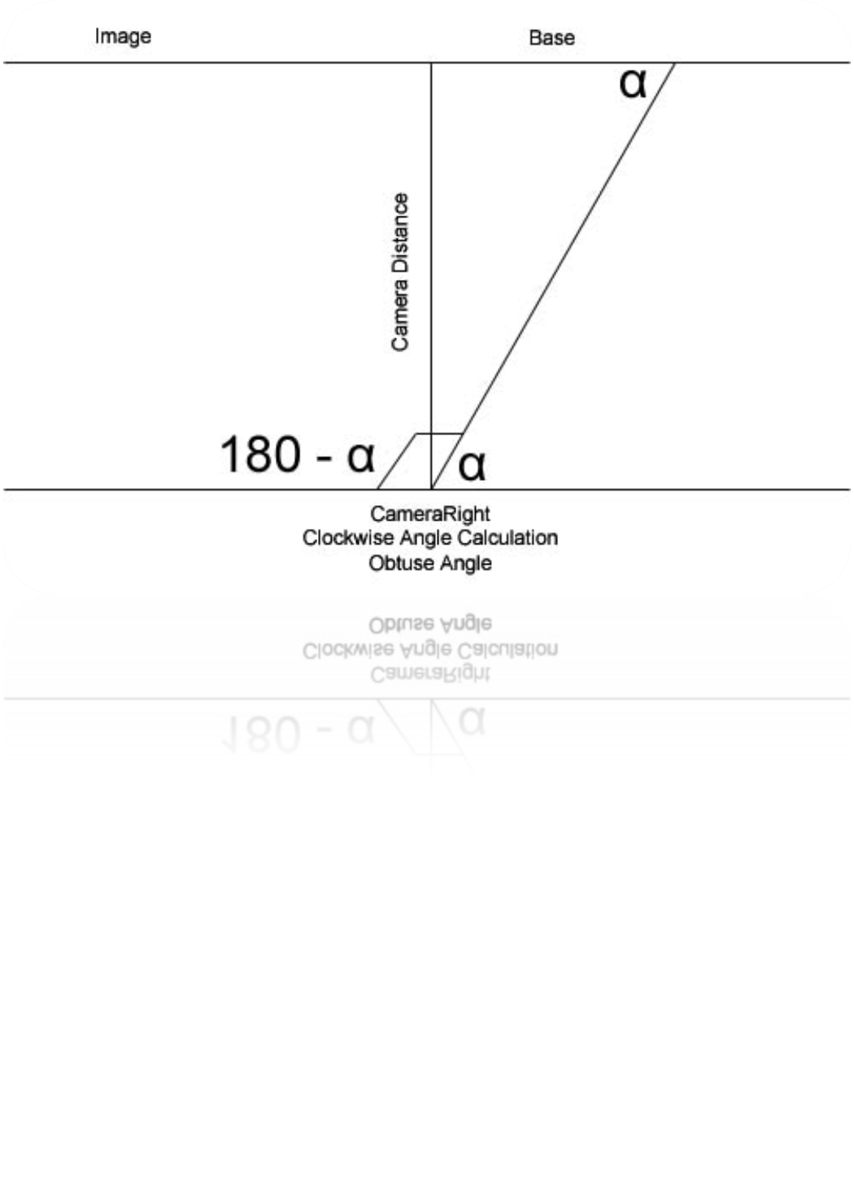

Slide 29
Depth Perception
Depth = StereoDistance x Sin( α ) x Sin( β ) / Sin( α + β )
Hence, 2D to 3D transformation of a point and thus of an edge and eventually of the whole object

Slide 30
Object Identification
Input: List of 3D edges of object
Output: Identification of object

Slide 31
Object Identification
Identifying objects in terms of primitives: points, lines and rectangles
An edge represents a line
For rectangle:
  Must be a closed path of four lines
  All four points of the closed path must lie in the same plane
  All the interior angles must be 9 0 degrees

Slide 32
Object Identification
For verifying common plane of all four points, we form equation of plane formed by any three points and plug in the fourth point
If it satisfies the equation then they lie in the same plane otherwise not

Slide 33
Object Identification
For table:
  A rectangle with four lines intersecting with four points of the rectangle
  Lines must be in the same plane
  Each line must form 9 0 degree angle with the plane of the rectangle

Slide 34
Object Identification
For verifying common plane, we plug in the non-intersecting points of the lines in the equation of plane of rectangle
If common sign for all four lines then they lie in the same plane otherwise not

Slide 35
Object Identification
For chair
  A table with a rectangle having one line in common
  Rectangle must form 9 0 degree angle with the base of the table
For finding angle between two planes, we find angle between their normals

